Slide 1

When 2 Work
Click to Begin

Slide 2
Error!
Please follow the on-screen
instructions to continue.
Go Back

Slide 3
Complete
Please navigate to the next module
in the course to continue.
Restart Course

Slide 4
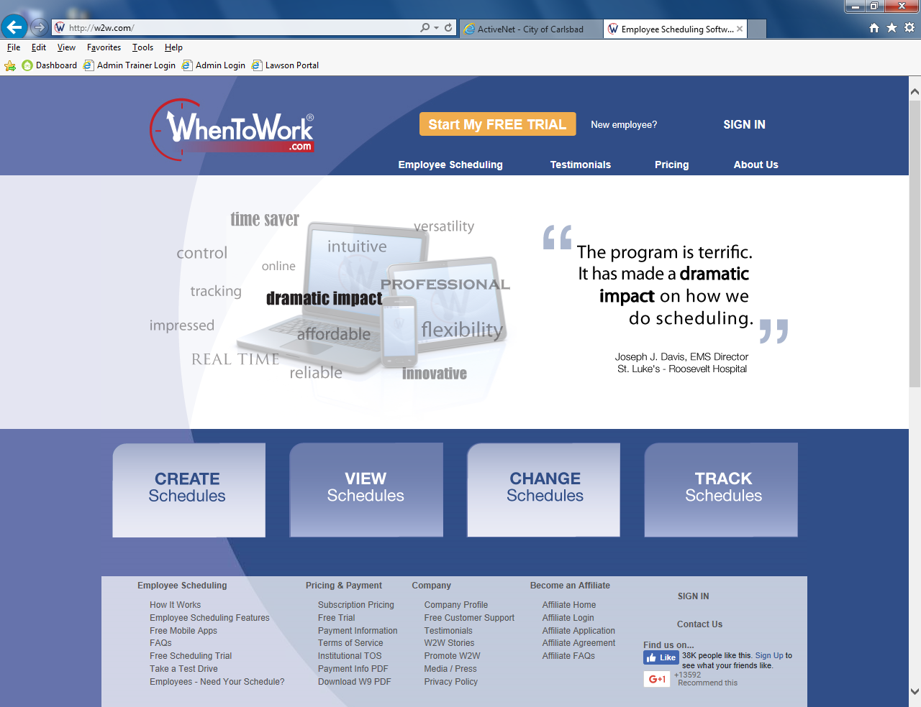
Tip:
Instructions here

Slide 5
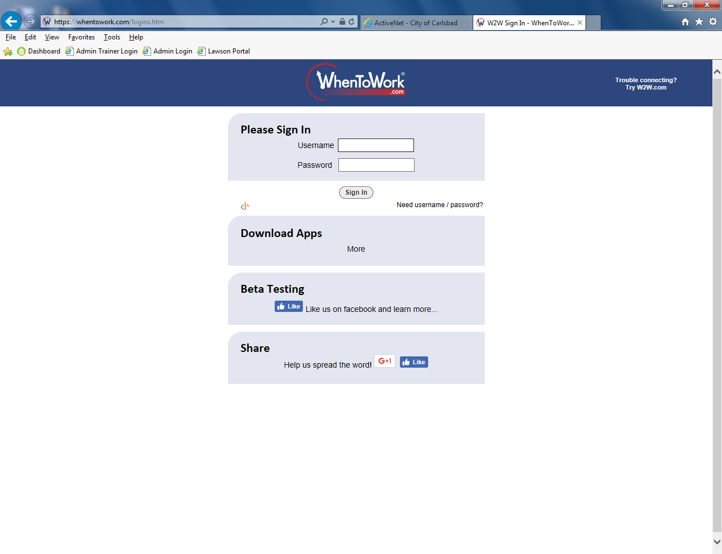
Tip:
Instructions here

Slide 6

Tip:
Instructions here

Slide 7
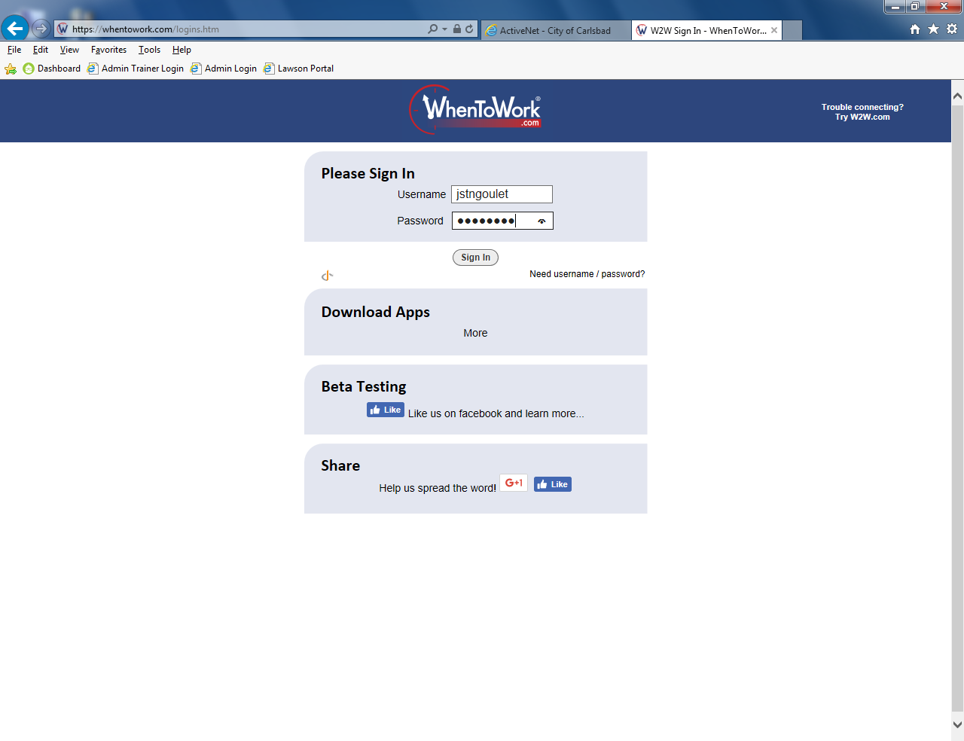
Tip:
Instructions here

Slide 8
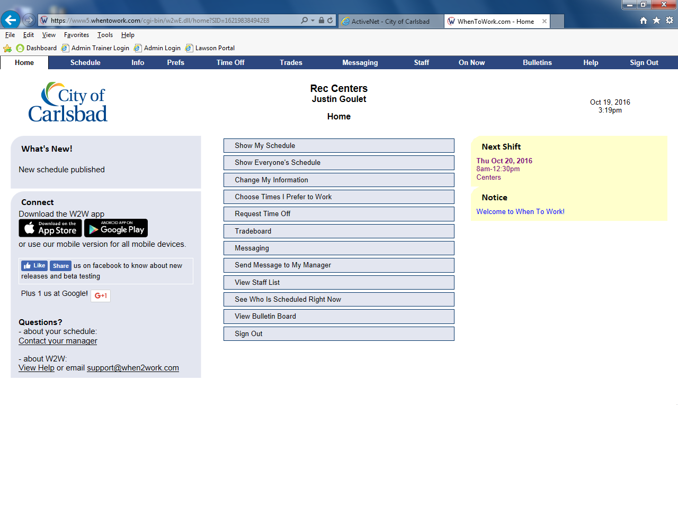
Tip:
Instructions here

Slide 9
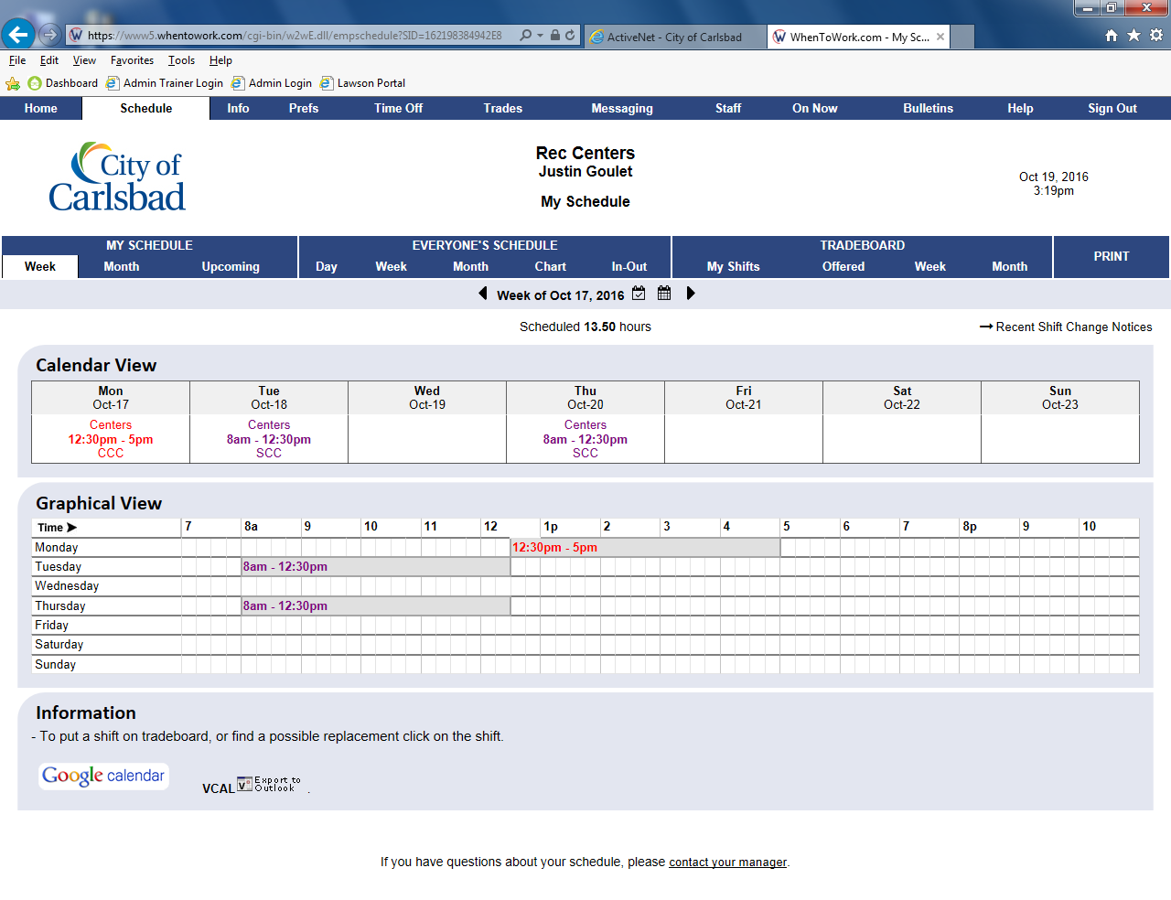
Tip:
Instructions here

Slide 10
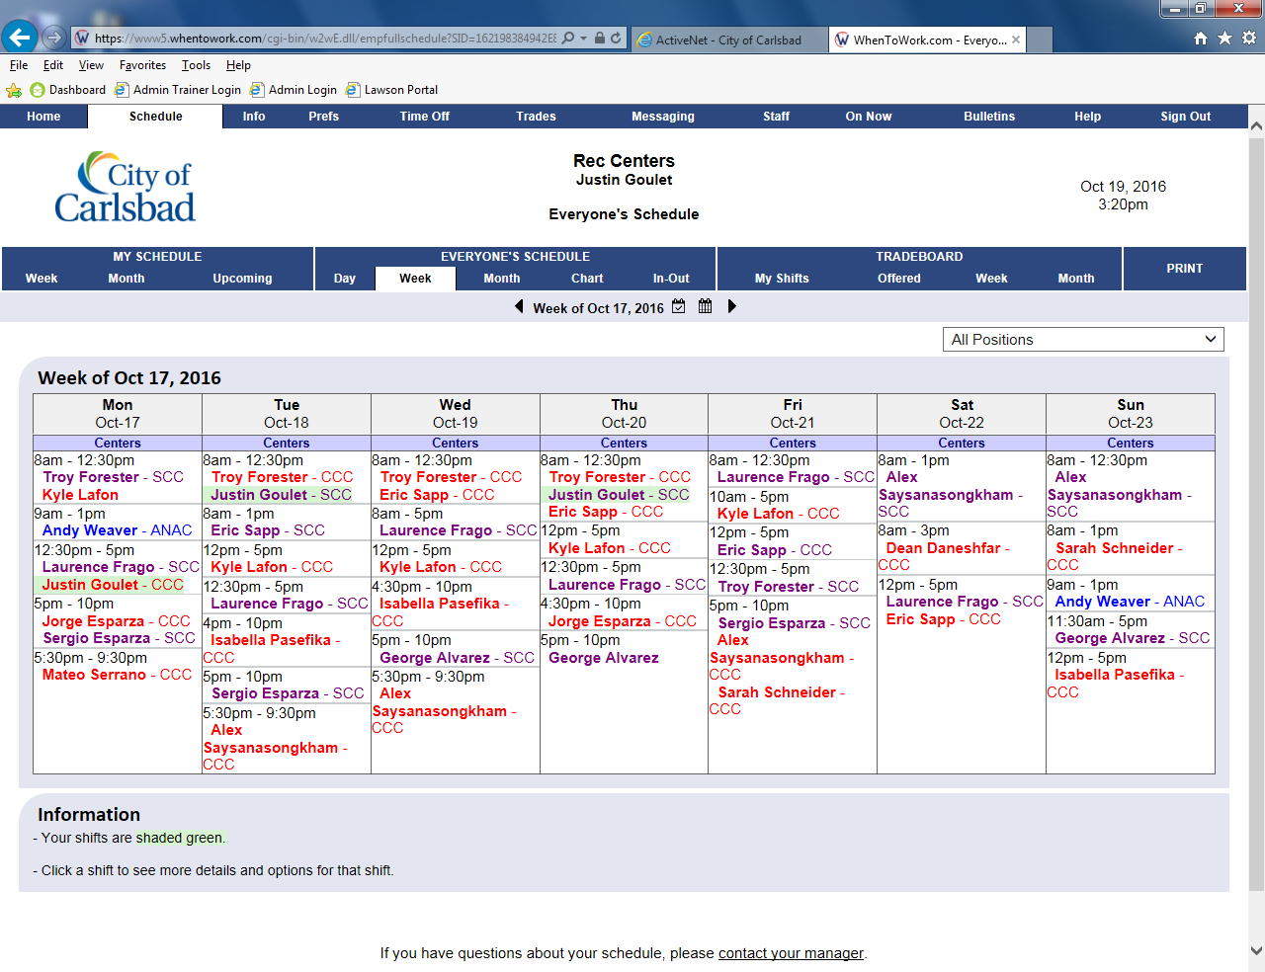
Tip:
Instructions here

Slide 11
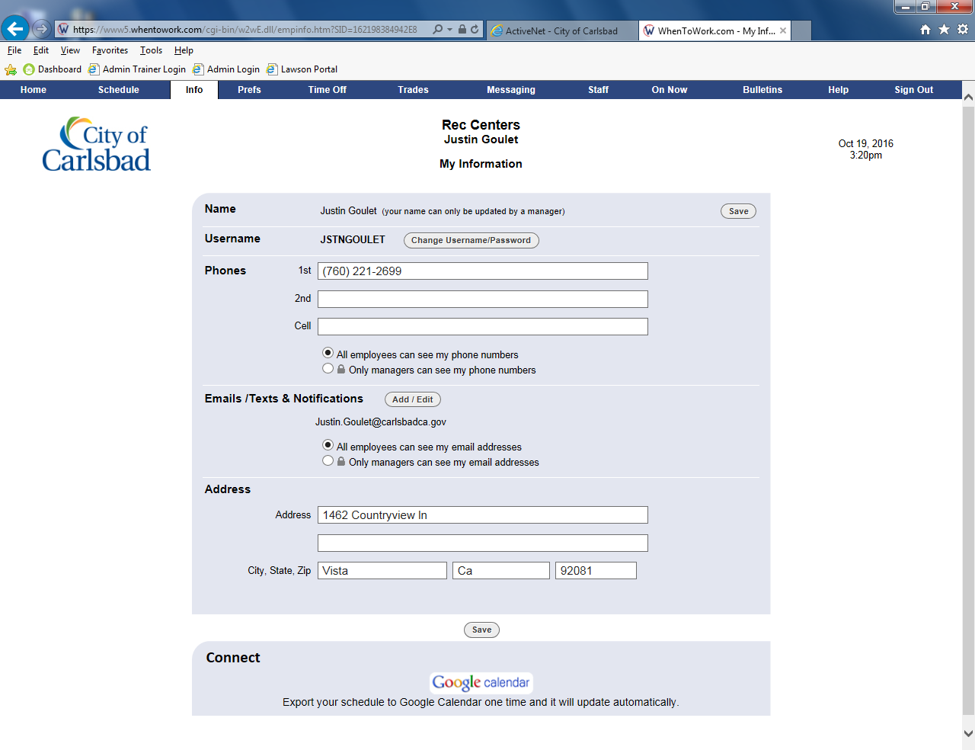
Tip:
Instructions here

Slide 12
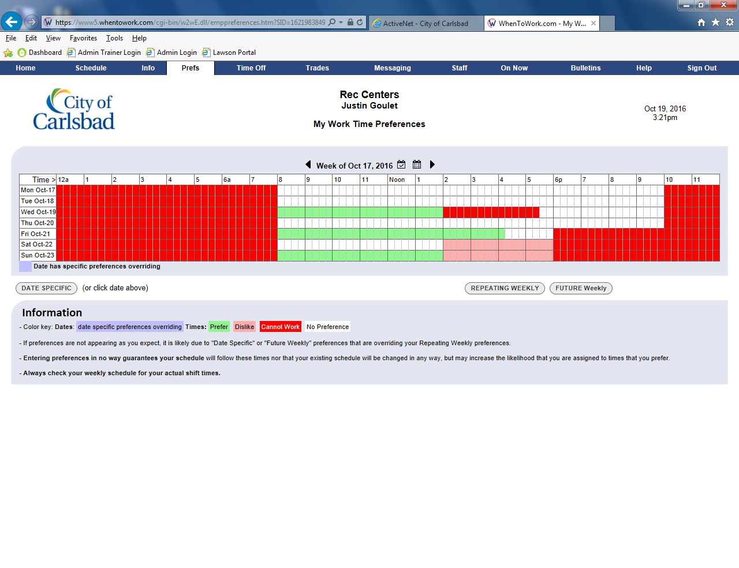
Tip:
Instructions here

Slide 13
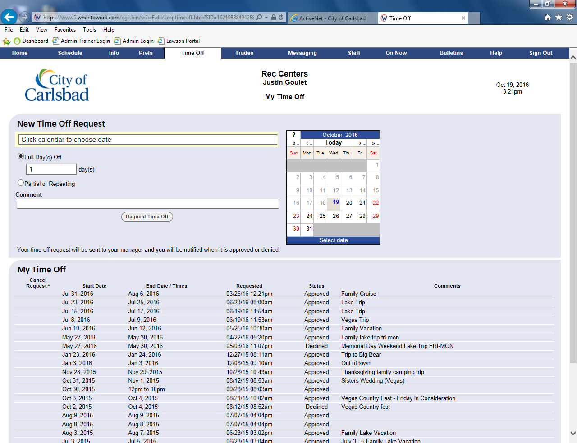
Tip:
Instructions here

Slide 14
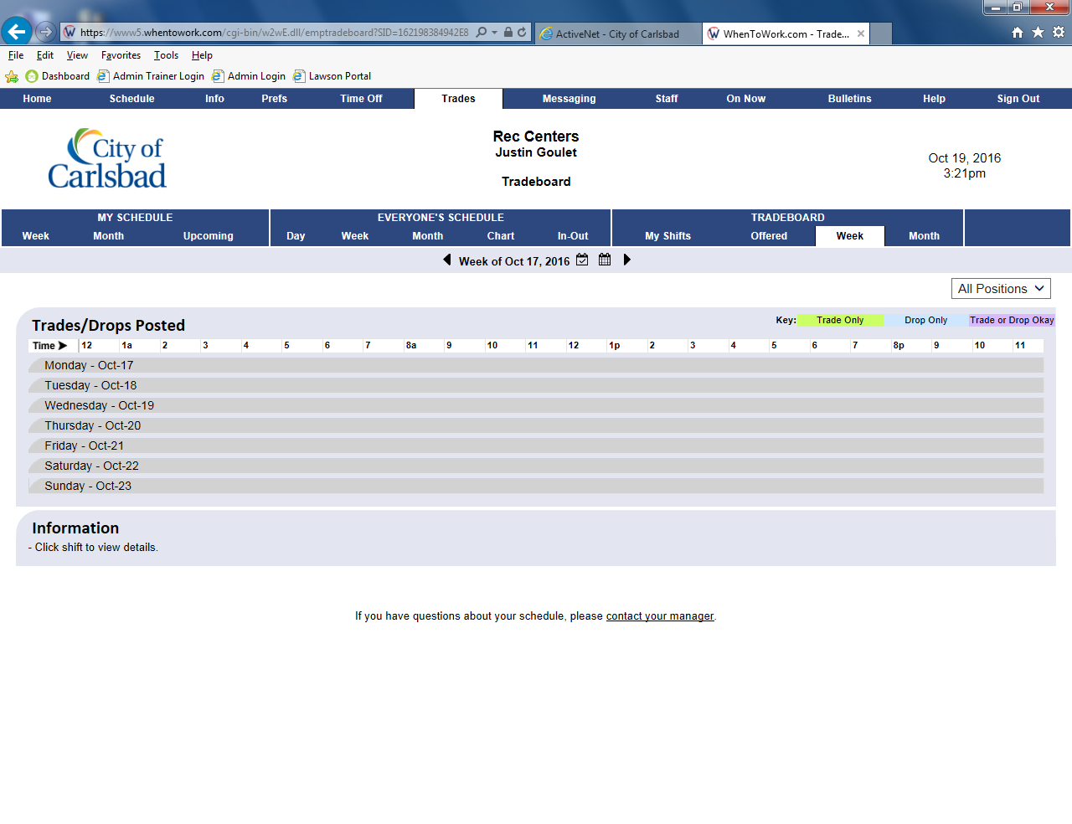
Tip:
Instructions here

Slide 15
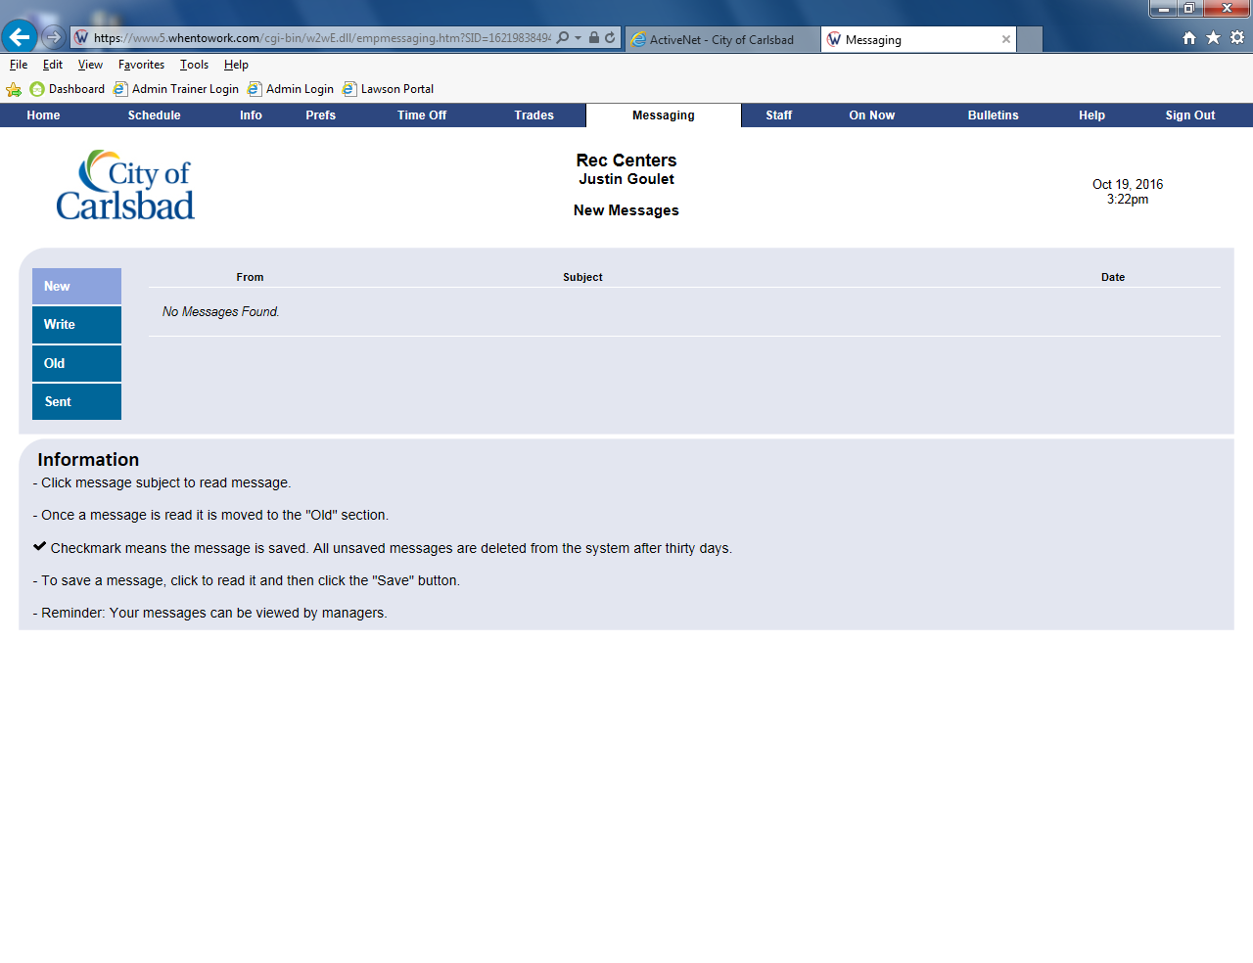
Tip:
Instructions here

Slide 16
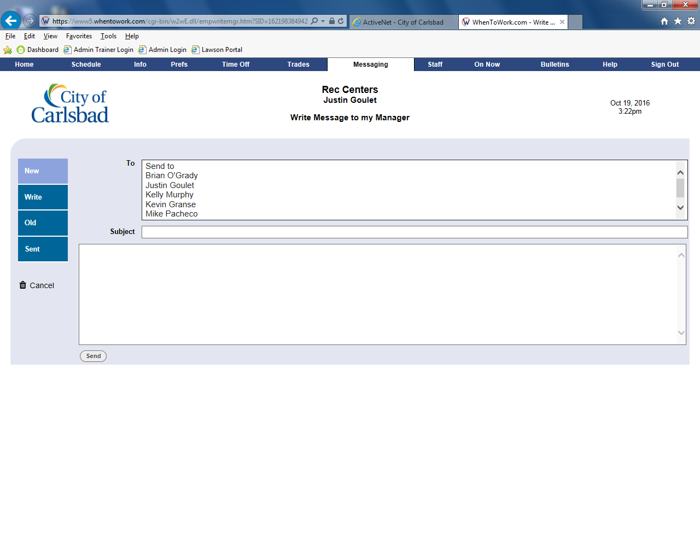
Tip:
Instructions here

Slide 17
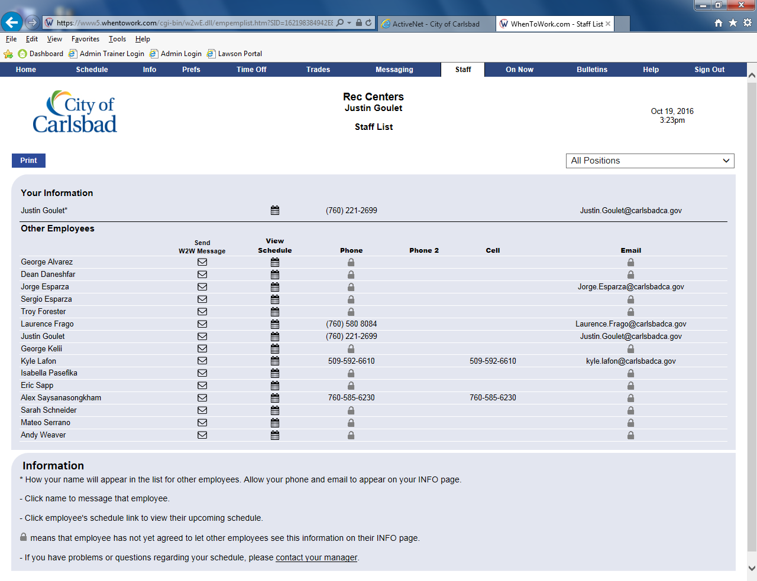
Tip:
Instructions here

Slide 18
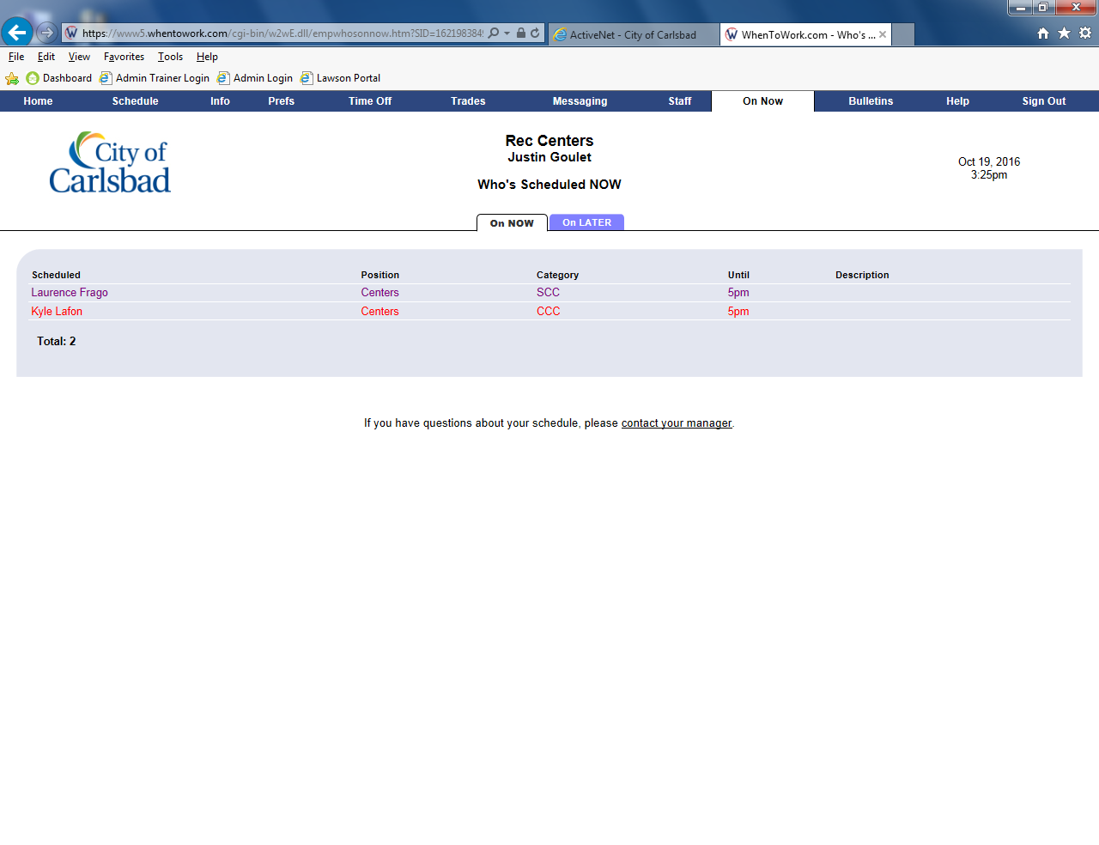
Tip:
Instructions here

Slide 19
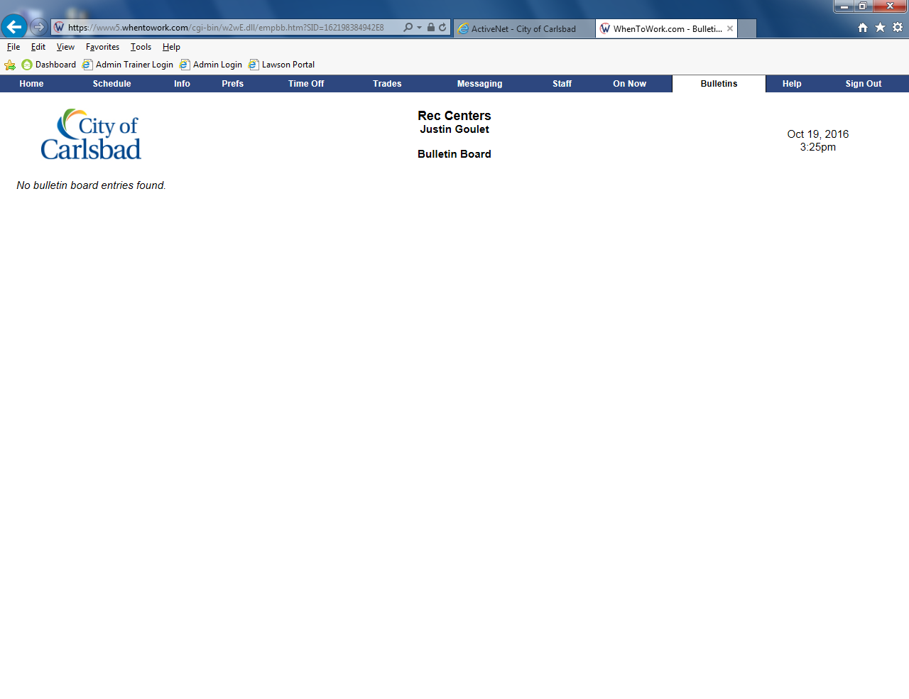
Tip:
Instructions here

